Slide 1
Political and constitutional development 1935-1947
Government of India Act 1935
1937 elections and formation of congress ministries
1940 Pakistan Resolution
Cripps Mission 1942
Cabinet Mission 1946
3rd June Plan and transfer of Power

Slide 2
Government of India Act 1935
Three lists of subjects were drawn up
Federal list
Federal government could make laws in the subjects given
Provincial list
Provincial government could make laws in the subjects given in the list
Concurrent List
Both Federal and provincial government could make laws
System of dyarchy was transferred from provinces to center.
Sindh was separated from Bombay, and Orissa Separated from Bihar.

Slide 3
NWFP was made province and Burma was separated from British India.
Special powers given to the governors of the provinces to protect the rights of the minorities.
India was divided into 11 provinces; Bihar, Orissa, Bengal, Punjab, Bombay, Madras, Sindh, NWFP, Central Provinces and Berar, United Provinces.
1937 elections and formation of Congress ministries
The provincial elections were announced soon after the passage of the Government of India Act 1935 in 1936-37
Results of elections
The results of the elections were disappointing for the Muslim League, as the Congress won majority seats and formed ministries in eight provinces. Bihar, Orissa, Berar and Central Provinces, NWFP, Assam, Madras and Bombay. In Punjab, Unionist party formed ministry. In Bengal, a coalition government was formed of Congress. In Sindh, Sindh united party won major seats.

Slide 4
Muslim league failed to win seats in the Muslim majority provinces but managed to get seats in Muslim minority province like UP.
Pakistan Resolution 1940
British declared war against Germany and made India part of War without taking opinions of the Indian Legislators, due to which Congress ministries resigned.
After two years of Congress rule the Muslims have realized that if the British left India then the Congress will dominate in the central legislature. Due to which Muslim league changed its politics from united India to partition of India.
Muslim League presented the Pakistan Resolution in Lahore. A.K Fazl ul Haq presented the resolution and Jinnah presided the session.

Slide 5
Text of the Lahore Resolution 1940
“No constitutional plan would be workable in this country or acceptable to the Muslims unless it is designed on the following basic principles, namely, that the geographically contagious units are demarcated into regions which should be so constituted, with such territorial readjustments as may be necessary, that the areas in which the Muslims are in a majority as in the north-western and eastern zones of India should be grouped to constitute independent states in which the constituent units shall be autonomous and sovereign. Adequate, effective and mandatory safeguards should be specifically provided in the constitution for minorities for the protection of their religious, cultural, economic, political, administrative and other rights”

Slide 6
CRIPPS MISSION
March-April 1942 Sir Stafford Cripps, Leader of the House of Commons, came to India on March 22, 1942 to discuss the issue of transfer of power to Indians. This was the first serious attempt on behalf of British Government to discuss the issue of Pakistan and transfer of power to Indians. Cripps met Jinnah, Nehru and other Congress leaders. He heard Jinnah’s view on Pakistan and held discussions with other Indian leaders but ultimately published his draft proposals known as the “Cripps Proposals” in Indian newspapers on March 30. Jinnah termed these proposals as against the concept of Pakistan. The Congress also did not like the Cripps Proposals. Finally on April 12 Sir Cripps departed from British India and his mission failed.

Slide 7
Quit India Movement
August 1942 Upon Gandhi’s insistence the Congress demanded from the British Government to “quit India” and hand over power to the “Congress Caucus” which was calculated towards the “Hindu Brahman Raj”. A movement in this direction was started which failed because the Muslims and other minorities did not support Congress in this move. It also failed because Jinnah demanded from the British to “first divide and then quit”.

Slide 8
Jinnah-Gandhi Talks
September 1944 Jinnah-Gandhi Talks were held in Bombay. In these talks a number of meetings between Jinnah and Gandhi took place at Jinnah’s House in Bombay followed by exchange of a number of letters. Gandhi tried to give the impression that he was ready to accept the idea of Pakistan, though it was unnatural division of India, but after the transfer of power from British to Congress – a plea which Jinnah felt was a dodging trick by Gandhi. Thus Jinnah refused. Jinnah wanted Pakistan before the departure of British from India. Gandhi tried to confuse Jinnah on a number of issues regarding Pakistan Resolution which Jinnah clearly explained in the interest of Muslims and Pakistan. Thus Gandhi-Jinnah Talks failed.

Slide 9
Simla Conference
June-July 1945 The Second World War came to an end in Europe in May 1945. As promised by the British Government, 22 Indian leaders belonging to different parties including Jinnah, Gandhi, Nehru and others were invited to meet at Simla on June 25, 1945 for the purpose of settling the future of British India. This is known as Simla Conference which continued up til July 14, 1945 with some intervals. Quaid-i-Azam pleaded Pakistan’s case. AIML, headed by Jinnah, faced Congress leaders as equals. Pakistan issue was the single issue on which the Quaid was not ready to surrender. The Congress did not agree. On this plea, the British announced failure of the Simla Conference.

Slide 10
August 1945 Announcement of Elections: 1945-1946.
August-November 1945 Jinnah and other AIML candidates started their election campaign, especially in the provinces which were to form Pakistan. Sindh, Balochistan and NWFP (now KP) were specially concentrated apart from the Punjab, Bengal and Assam. A number of Muslim leaders left Congress and other parties, and joined the AIML. This was a very successful election campaign. For instance, Khan Abdul Qayyum from NWFP and Mian Iftikharuddin from Punjab left Congress and joined AIML. Similarly, other desertions took place and the AIML became very popular.

Slide 11
Central Assembly Elections
November-December 1945 Elections for the members of Indian Central Assembly were held. In these elections 30 seats were reserved for the Muslims. All these seats of the Central Assembly were won by AIML candidates. Thus AIML’s victory in these elections was 100%. The candidates backed by the Congress and other parties were miserably defeated.

Slide 12
Provincial Assembly Elections
January-April 1946 Elections to 11 provincial assemblies were held in different provinces. 491 seats were reserved for Muslims in the provincial assemblies. Out of 491, 429 seats were won by the Muslim League candidates. Thus the Muslim League victory was about 90%. These elections proved that 90% majority of the Muslims of the Indo-Pak subcontinent were in favour of Pakistan. In the Punjab Assembly, majority of 88 members out of 175 were with the Muslim League. Of the 88 members claimed by Nawab Mamdot, leader of the Punjab Muslim League, 73 belonged to the Muslim League, plus 5 Independent and 10 others. Despite this, Malik Khizar Hayat Tiwana’s Ministry was installed, although his Unionist Party was able to win only 20 seats. This was to facilitate him because of the Congress’ designs against Pakistan. As a result, agitation against Khizar started which resulted in his resignation towards the end of March 1947.

Slide 13
Socio-economic conditions of India
India was passing through an economic crisis after the WW-II.
The inflation and the unemployment
Announcement of Cabinet Mission
The new British government headed by Lord Attlee, announced a mission for India consisting of three cabinet ministers on February 19, 1946.
Cabinet Mission consisting of Lord Pethick-Lawrence, Secretary of State for India, Sir Stafford Cripps, President of the Board of Trade, and Mr. A. V. Alexander, the First Lord of the Admiralty arrived in Delhi on March 24

Slide 14
The mission was given the task to resolve the constitutional issues with the Viceroy and the Indian political leaders.
Major points
Indian Union would be established comprising of British India and the states. The Union would deal with the defense, foreign affairs, and communication.
Three groups of provinces would be established
Group A: Punjab, Sind, Bengal, NWFP
Group B: Madras, Bihar, Orissa, UP, CP, Bombay
Group C:Aasam, Bengal

Slide 15
All residuary powers would be vested in the provinces
Each province have seats in proportion to its population
Each province have the option of opting out of the provincial groups after 10 years.
An interim government would be established with all portfolios held by the Indians.
Failure of interim government formation.
The Viceroy declared that whichever party was willing to join the interim government would be invited to form the interim government.
INC refused to join the interim government, on the other hand the AIML decided to join the government. but Viceroy did not ask Jinnah to form government.
Jinnah decided to take direct action along with withdrawing their acceptance of the Cabinet Mission plan.

Slide 16
Direct Action Day
August 16, 1946 On a call by Jinnah, this day was celebrated all over British India as “Direct Action Day”. Demonstrations against the British and the Congress were carried out throughout the country. Muslims and the Hindus clashed with each other at certain places in which hundreds and thousands of Muslims and Hindus were killed or injured. This forced the Congress leadership and the British Government to come to terms with Jinnah.

Slide 17
Transfer of power to India and Pakistan from British government
The British Prime minister Lord Attlee declared in British parliament that India would be granted independence by February 1948.
Lord Mountbatten was sent to India with the orders by the British government to transfer the power up to the June 1947.
3rd June Plan
After having discussion with political leaders of India, Lord Mountbatten decided to partition India.
Both AIML and INC gave their acceptance to the draft partition plan. Mountbatten went to England to take approval of the British government.
The British government approved the partition plan, which was known as the 3rd June plan

Slide 18
Major points
The Punjab and the Bengal legislature would decide to partition the province or not
Referendum in NWFP
Baluchistan would be asked to decide their future
A boundary commission was formed to demarcate the borders.
Both countries shall have their own Governor-General
Military assets shall be divided among the two countries
States shall be free to join one country or another
Radcliff award
A Boundary commission was setup under the chairmanship of Sir Cyril Radcliff to demarcate the borders of Punjab and Bengal.

Slide 19
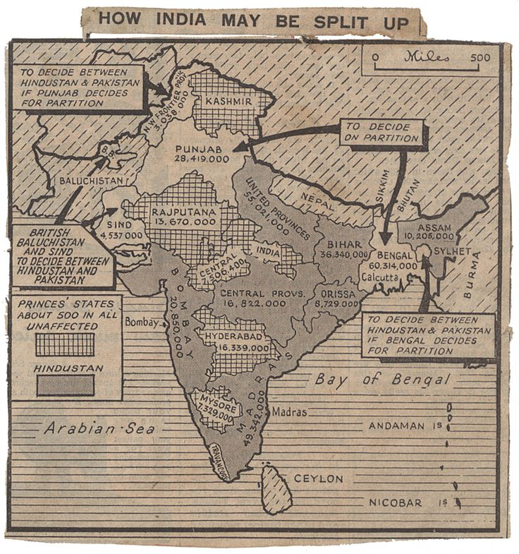

Slide 20
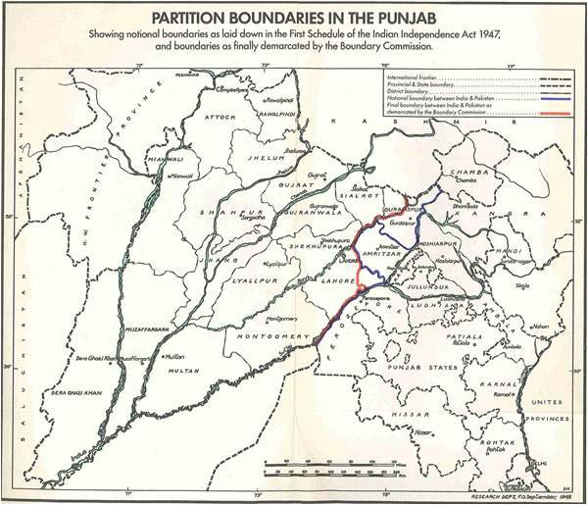

Slide 21
